Slide 1
Group code – G17

Slide 2
Group Members
1)Vikrant Khedkar
2)Sundar Paul Dakkumalla
3)Rupesh Borate
4)Prasen Waikar

Slide 3
Topics submitted for approval
1)Online Bonafide Certificate Generator
2)Webpage Builder
3)College Management System

Slide 4
Topic Selected By Us
Online Bonafide Certificate Generator

Slide 5
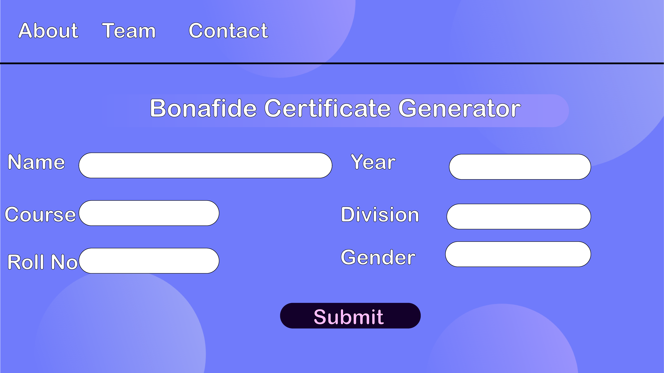
Initial Design Concept

Slide 6
Resources
HTML
CSS
JavaScript
PHP
SQL
Other resources

Slide 7
END

